Slide 1
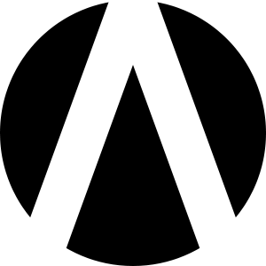
HYPERLOOT

Slide 2
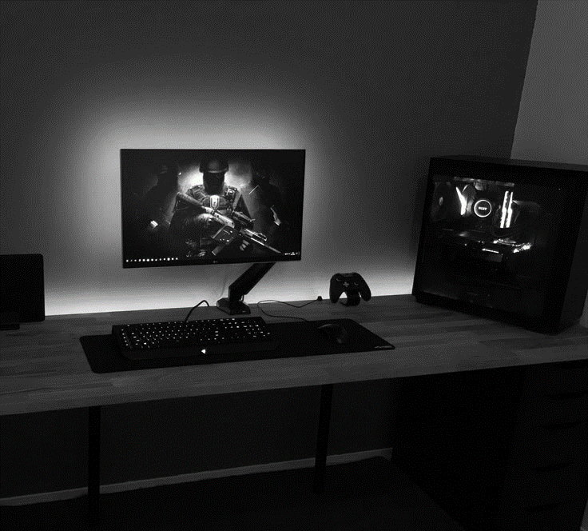
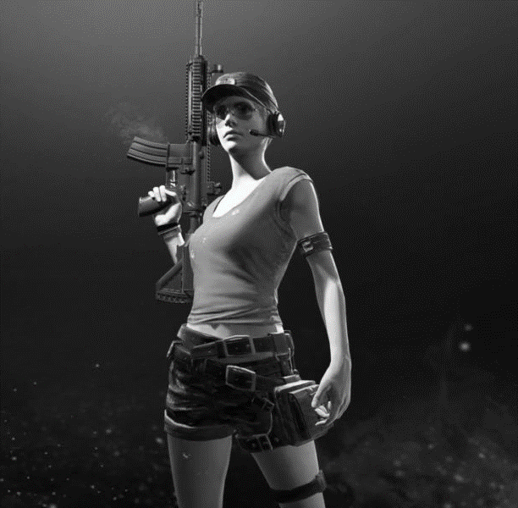
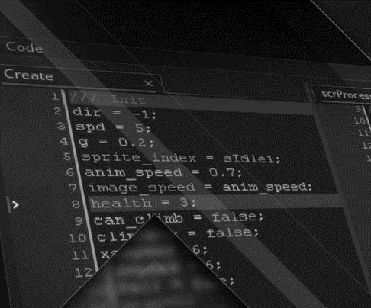
GAMES
OWNERSHIP
TOOLS
Every game is built around an internal economy.
At this moment all of them are closed.
A one-way profit flow with limited capitalization.
There is no real digital asset ownership.
Even if you paid money, the ownership is never transferred and the asset loses value with the game.
There is no way to exchange the value between games. That means all of the projects capitalizations are cut off when they can be multiplied.

Slide 3
SOLUTION
A tradeable token standard paired with an Ethereum-based blockchain platform. Easily integrated, quickly scaled, suited for pre-existing games.
CREATE
TRADE
PROMOTE
You can create multiple assets for every game. Anything can be turned into value, starting with items and ending with user accounts.
Creating a unified capitalization pool regulated by an open economy. Well-crafted and demanded items will rise in cost, increasing market volume.
Use cross-trading capabilities to promote each other games. It's better-than-free advertising you pay with using your own items, no middleman needed.

Slide 4
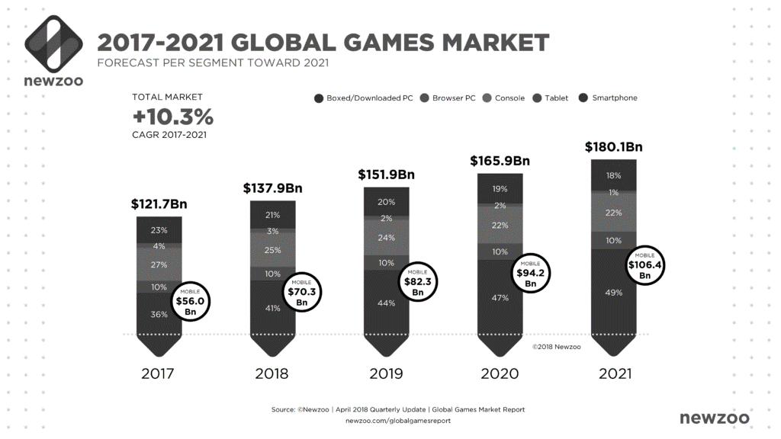
MARKET VALIDATION
According to the wallet count – current active player base of crypto games is only about 70 000 people. Creating a standard and a platform for cross-game trading, while adding non-blockchain games into the mix will bring next to 400 000 more users that are currently trading.
2,600,000,000
Gamers are active worldwide. They are avid device users able to navigate the trade but not interested in joining in the convoluted trading space existing today.
1,000,000
Of developers are competing for gamers attention every day. Current situation creates inflated marketing budgets and lowers game quality, creating questionable business practices.
8000
A total number of games released on Steam alone in 2017. Considering the market share of mobile devices, that number would double. Consoles would add another thousand to it.

Slide 5
MARKET SIZE
Gaming market is one of the few markets to steadily grow in double digits annually for the last decade. However, the development tools have hardly changed, all the while the community landscape evolved drastically.
150
30
10
BILLIONS
BILLIONS
PERCENT
The total value of the gaming market in 2019.
It is set to reach 180 by 2021 with mobile gaming becoming a 100-billion industry.
Estimated in-game item trade volume in 2017 (Juniper research). This number is set to reach 50 billions by 2022.
Is the market share realistically achievable within a 1,5 year-span. This is estimated based on the number of gamers trading on third-party websites.

Slide 6
PRODUCT
FOR GAMERS
1. Download or get your wallet in game
2. Earn digital assets
3. Trade with your fellow gamers or between the games you play
FOR DEVELOPERS
1. Integrate our wallet into the game
2. Convert in-game items into crypto assets
3. Set prices in tokens and distribute to your player base

Slide 7
BUSINESS MODEL
This business model is adapted to the trading. Additionally, we will charge 5% of the asset price for it creation.
VALUE
PROPOSITION
GROWTH
INCOME
Estimated trading volume $3 billion. Within the platform by 2019
We take 0.5% commission on trading
The market growth is predicted at CAGR 13%
4-year platform revenues of $ 819 millions

Slide 8
MARKET ADOPTION
DEVELOPERS EVENT
Participating in targeted events monthly top gather feedback and provide the community with valuable tools. Setting up a hackathons schedule to integrate the best sourced solutions into the platform.
PARTNERSHIPS FOR LIQUIDITY
Partnering with leading trading platforms for in-game items (Opskins, G2A, Skinbaron, Decentraland). Partnering with large gaming titles to demonstrate the feature set of the product.
DECENTRALIZED, TOKEN-POWERED COMMUNITY
Delivering a communication and interaction platform to empower gamers to participate in game development. Improving our platform development using crowdsourcing (open-sourcing the project to GitHub).

Slide 9
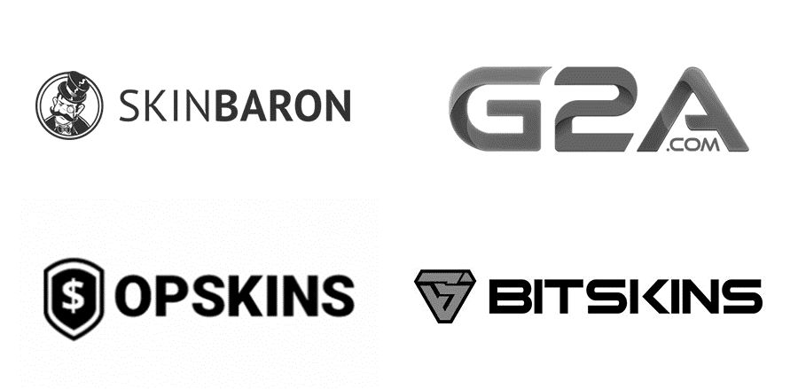
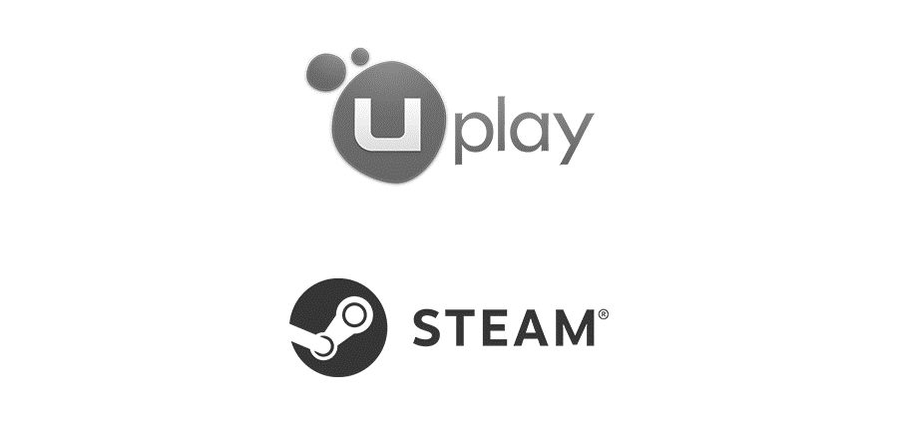
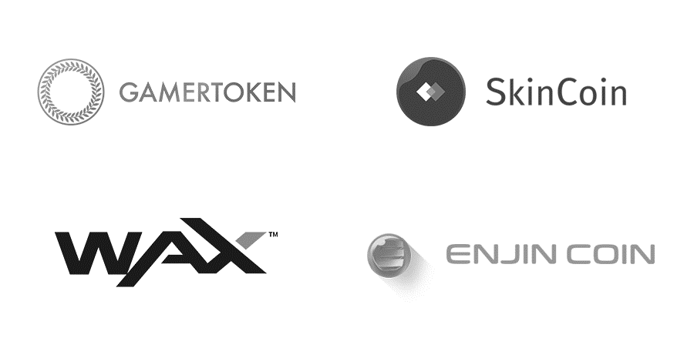
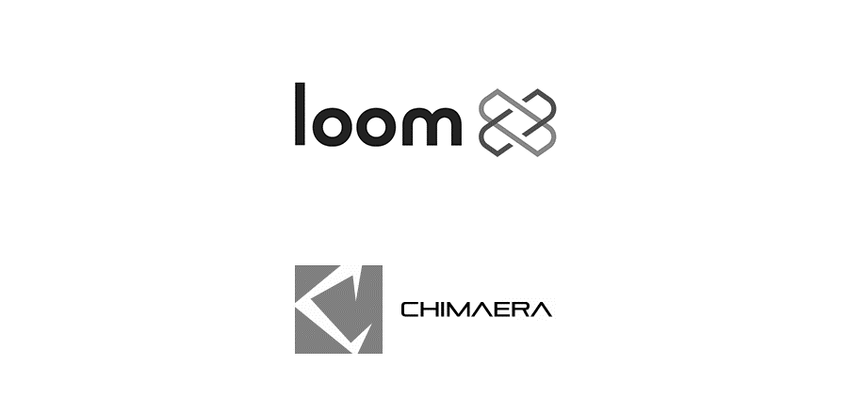
COMPETITON
CENTRALIZED
TOOL
PLATFORM
DECENTRALIZED

Slide 10
1ST TO MARKET
EASE TO USE
DEVELOPER INCENTIVES
There is no unified solution for cross-game trading. Bringing it to the market will attract a large number of potential users.
First crypto-asset platform suitable for adoption by pre-existing games.
Developers get access to an extra revenue stream along with: airdrops, integration bounties, internal funds, crowdsourcing.
INTEGRATE ONCE
NETWORK EFFECT
DAO GOVERNANCE
With minimal code alterations. Your assets will forever exist multiplying your capitalization.
One platform for trading and developer-to-community interaction. Co-owned by both.
Powered by token emission and distributed among the token holders. Voting makes every decision community-owned.

Slide 11
GET IN TOUCH
We are always up for a chat. Let us know if you wish to know more, or even grab a cup of coffee and talk your favorite game. Or maybe you're a developer looking to get involved? Hit us up!
HYPERLOOT

